Slide 1

Fake NEWS PREDICTION.
Machine learning approach
AHMAD MAKKI MSDSF23M022

Slide 2
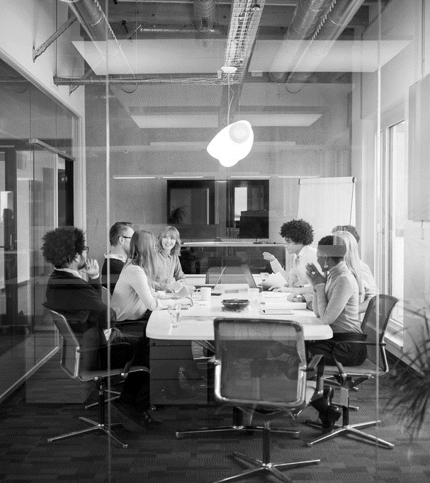
outline
INTRODUCTION OF PROJECT
METHODOLOGY
MODELS USED
RESULTS
CONCLUSION
Q&A

Slide 3
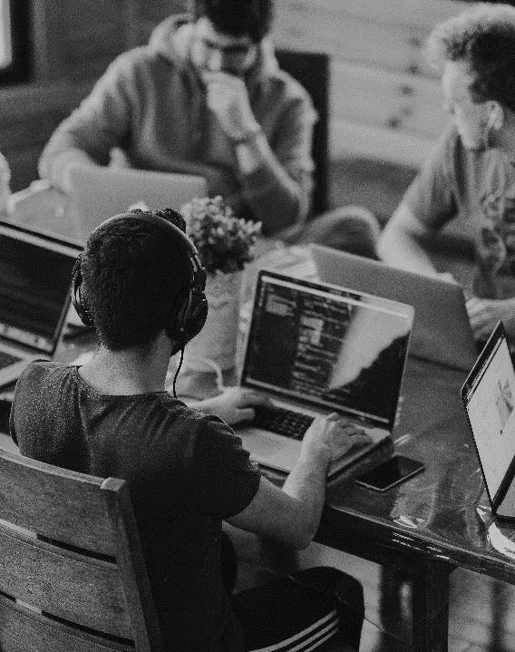
INTRODUCTION
BACKGROUND
Brief introduction to the problem: Rise of fake news and its impact
Importance of detecting and preventing the spread of misinformation
Goal of the project: To build a predictive model for identifying fake news
Importance of identifying and combating fake news for information integrity

Slide 4

METHODOLOGY
oVerview
Overview of the methodology used in the project
Data collection process: Sources of data, size of dataset
Data preprocessing: Cleaning, handling missing values, text processing
Feature engineering: Selection of relevant features
Splitting data into training and testing sets
Use of machine learning techniques

Slide 5

Models
Algorithms
Logistic Regression
Random Forest Classifier
Support Vector Classifier (SVC)
Decision Trees Classifier
Gradient Boosting Classifier
Naive Bayes Classifier
Binary Classification Neural Network (TensorFlow/Keras)

Slide 6
results
MODELS | TRAINING ACCURACY | TESTING ACCURACY
Logistic Regression | 0.9865 | 0.9790
Random Forest Classifier | 1.0 | 0.9935
Support Vector Classifier (SVC) | 0.9990 | 0.9889
Decision Trees Classifier | 1.0 | 0.9918
Gradient Boosting Classifier | 0.9721 | 0.9673
Naive Bayes Classifier | 0.9782 | 0.9550
Neural Network (TensorFlow/Keras) | 1.0 | 0.9901

Slide 7

conclusion
Summary of key findings
Discussion on the effectiveness of the models
Limitations and challenges faced during the project
Future work and potential improvements
Acknowledgment of any external factors that may have influenced the results
Summary of key findings
Discussion on the effectiveness of the models
Limitations and challenges faced during the project
Future work and potential improvements
Acknowledgment of any external factors that may have influenced the results
LOOKING AHEAD
Summary of findings
Discussion on the effectiveness of the models
Limitations and challenges faced during the project
Future work and potential improvements
Acknowledgment of any external factors that may have influenced the results

Slide 8
Thank you

